Slide 1
LESSON 13.4
Born-Haber Cycles

Slide 2
LESSON GOALS
I can interpret and determine values from a Born-Haber cycle for compounds composed of univalent and divalent ions

Slide 3
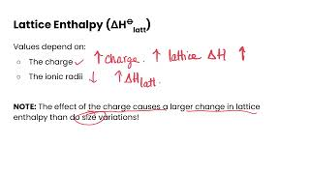
TASK 1: LEARN (MUST DO)
Watch the Born-Haber Cycles Definitions video
Complete the appropriate section of the guided note

Slide 4
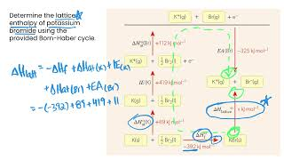
TASK 2: LEARN (MUST DO)
Watch the Born-Haber Cycles video
Complete the appropriate section of the guided note

Slide 5
TASK 3: PRACTICE
Complete the Born-Haber cycles practice (answers included)
Note: There are must do and should do questions included in this practice!

Slide 6
TASK 4: MASTERY CHECK (MUST DO)
Complete the Born-Haber cycles mastery check (see me when you are ready!)

